Slide 1
Interplanetary Timetable Travel to infinity and beyond
Transport via solar winds to inter planetary transport gateway and beyond

Slide 2
Travel to infinity and beyond
Mobile phone application
Start: Earth
Finish: Any planet but initially Mars
Using solar or beam driven sails
Has scope to be included as part of planetary journey planning, simulation and leisure activities.

Slide 3
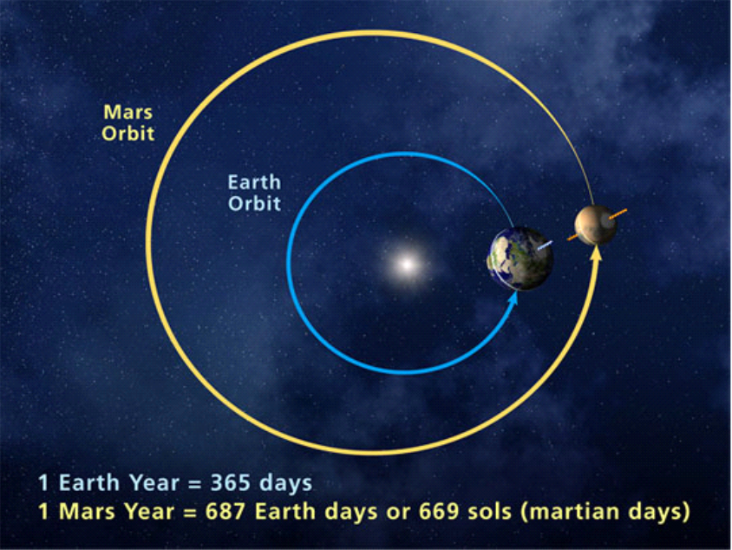
Shortest distance may not offer the safest optimum journey
Image from http://mars.jpl.nasa.gov/allaboutmars/extreme/martianyear/

Slide 4
Considerations and data requirements
Solar winds
Solar flares
Interplanetary transport network
Gravitational assist
Electromagnetic factors

Slide 5
Road Map
Build a prototype with using Earth to Mars rotational only. Ensure MMI is aesthetically pleasing.
Add for additional Planet or Moon
Sun solar calendar
Solar winds
Gravity assist concepts
Electromagnetic dangers
Solar system stationary objects
Interplanetary Transport Network

